Slide 1
TRAFFIC SIGN CLASSIFICATION
ARTIFICIAL INTELLIGENCE - 18CSC305J

Slide 2

IDEA
Road traffic accidents are primarily caused by driver error. Safer roads infrastructure and facilities like traffic signs and signals are built to aid drivers on the road. But several factors affect the awareness of drivers to traffic signs including visual complexity, environmental condition, and poor driver education. This study implements a traffic sign detection and recognition system with voice alert using Python. It aims to establish the proper trade-off between accuracy and speed in the design of the system.

Slide 3
IDEA
Four pre-processing and object detection methods in different color spaces are evaluated for efficient, accurate, and fast segmentation of the region of interest. In the recognition phase, ten classification algorithms are implemented and evaluated to determine which will provide the best performance in both accuracy and processing speed for traffic sign recognition.

Slide 4
Analysis
125
This study has determined that Shadow and Highlight Invariant Method for the pre-processing and color segmentation stage provided the best trade-off between detection success rate
100
75
(77.05%) and processing speed (31.2ms). The
Convolutional Neural Network for the recognition stage not only provided the best trade-off between classification accuracy (92.97%) and processing speed (7.81ms) but also has the best performance even with a lesser number of training data.
50
25
0
2018
2019
2020
2021
2022

Slide 5






Our Goals
The World Health Organization (WHO) in 2013 reported that road traffic accidents that result to loss of lives and damages to properties will continue to become a global challenge due to rapid motorization and insufficient action of national governments
01
The goal of this study is to help solve the problem of drivers neglect and lack of road education. Traffic signs defined by the Department of Public Works and Highways to be recognized must be strategically positioned, clear and fully visible and captured in good weather condition during daytime. The system will be able to provide voice alert.
02

Slide 6
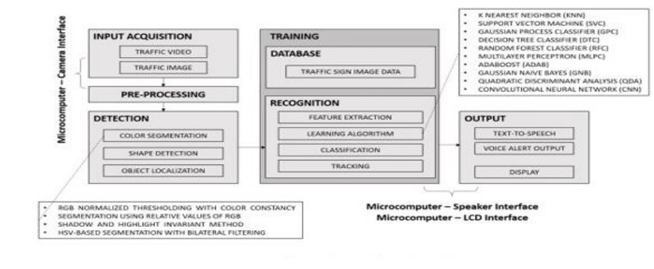
Architecture

Slide 7





LITERATURE REVIEW
The identification of road signs can be carried out by two main stages: detection, and recognition. In ‘detection’ research groups are categorised into three groups. The first group of researchers believes that traffic sign colours are important information by which traffic signs can be detected and classified. The second group believes that detection of traffic signs can be achieved by traffic sign shape only, and the third believes that colour together with shape make the backbone for any road sign detection.

Slide 8


LITERATURE REVIEW
Thus, there are three major approaches to detecting traffic signs: detection using colour information, detection using shape information, and detection using both colour and shape information. All of the reviewed papers used images form real traffic scenes which are similar to the images collected during this research.

Slide 9
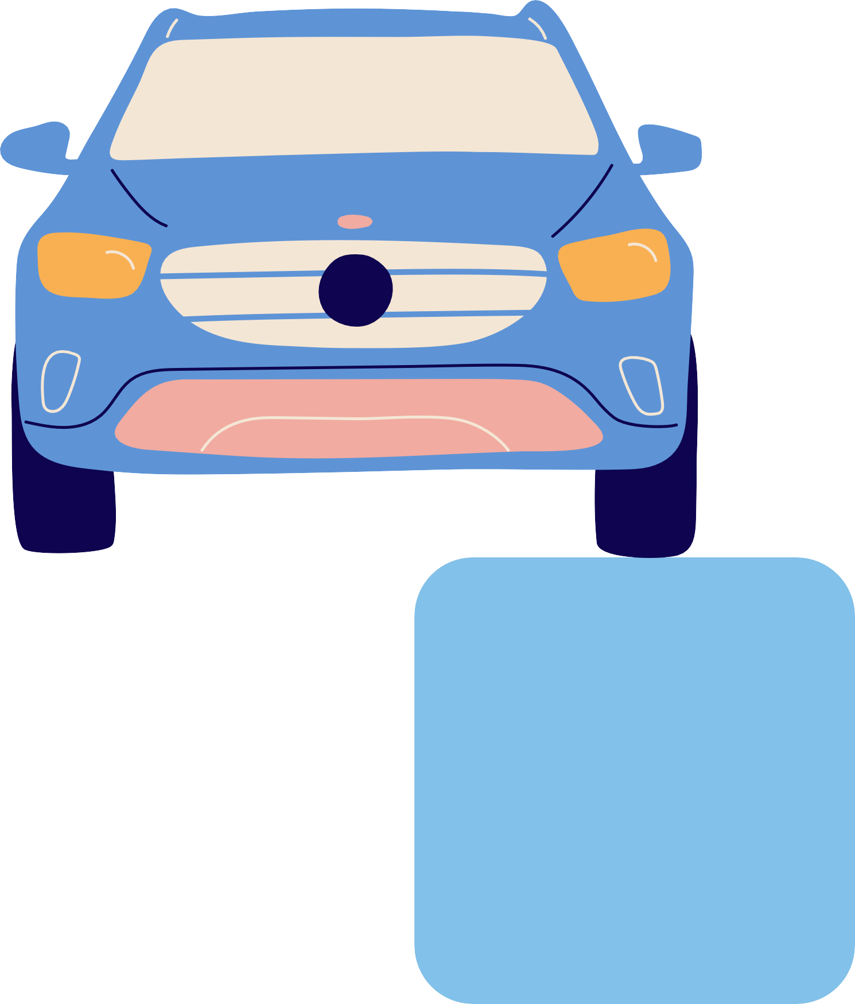
METHODOLOGY
TRAFFIC SIGN DATASET
it consists of large number of images. The traffic signs are of different variety, background, and colour variation which in turn will help the model to perform accurately
MODEL ARCHITECTURE
Sequentially add the layers in the order: two convolutional layers, one pooling layer, dropout layer, flattening layer, dense layer, again a dropout layer and finally the dense layer
DESIGN/METHOD
There is a csv file which consists of the pairs of traffic sign name and the class ID. This file helps to load the labeled data.
GRAY SCALE
Converting the RGB data set into gray scale is one of the important steps before classification using CNN.

Slide 10
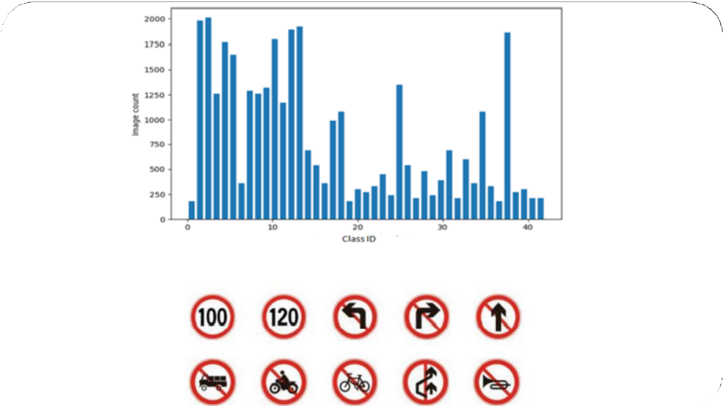
DATASET & STATS
Dataset A total of 2,194 images are used to test the detection phase of the models. Of these, 2,170 are traffic images from online sources with traffic sign having different viewing angle and position on image
Before moving on to detection or classification, the most important part is the availability of a generalized dataset. A prediction model is trained using this dataset and predictions are done for test dataset.

Slide 11
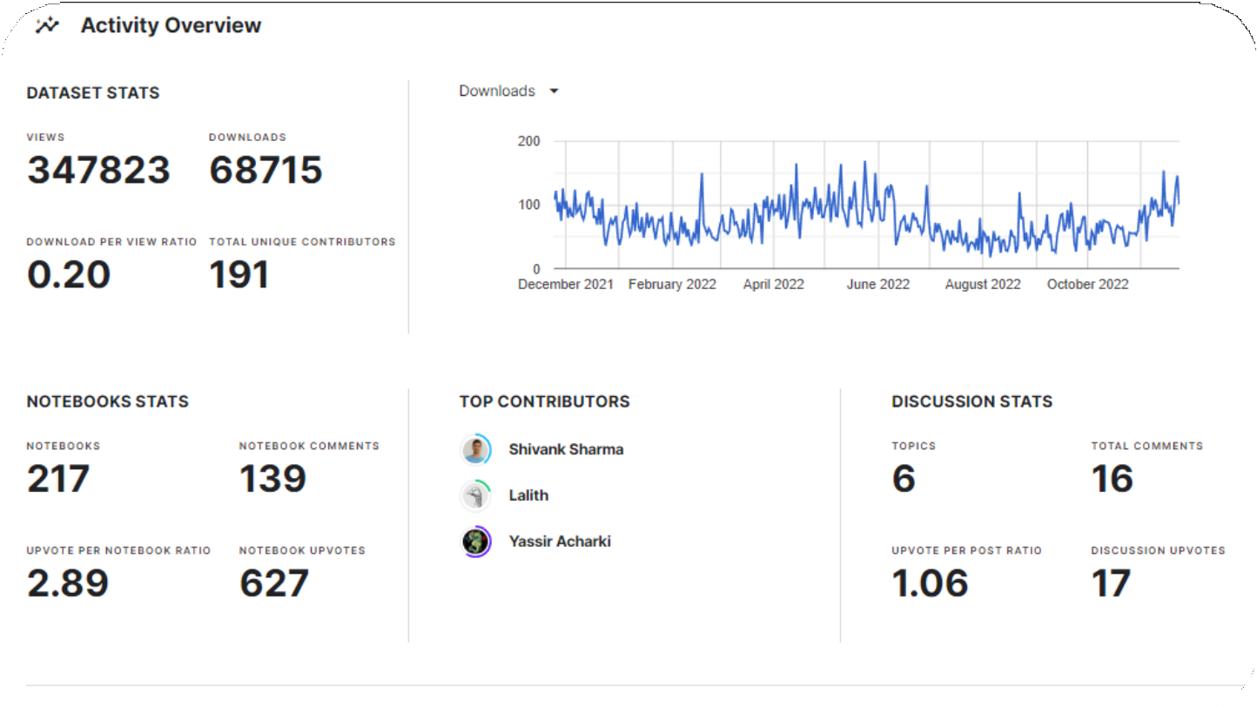
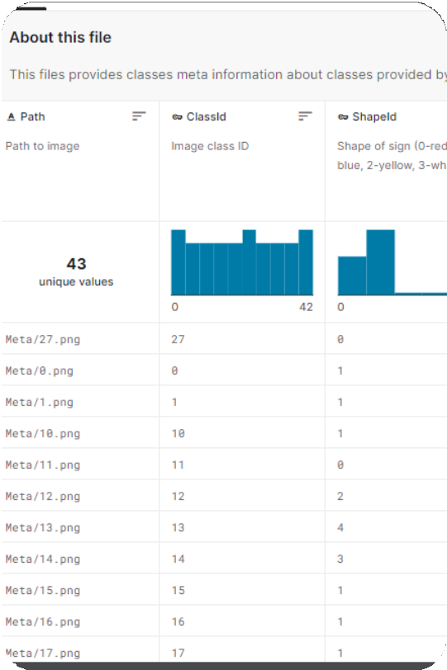
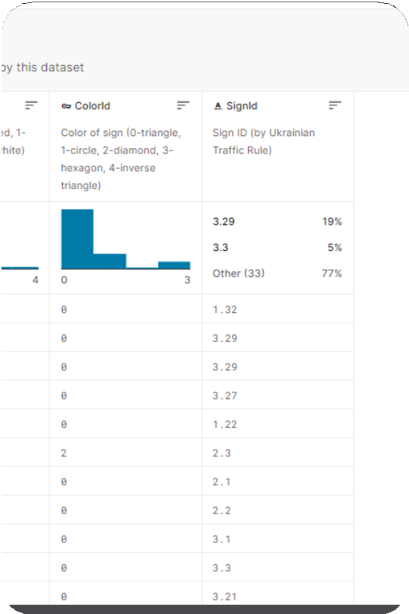
DATASET & STATS
LINK: https://www.kaggle.com/datasets/meowmeowmeowmeowmeow/gtsrb-german-traffic-sign

Slide 12

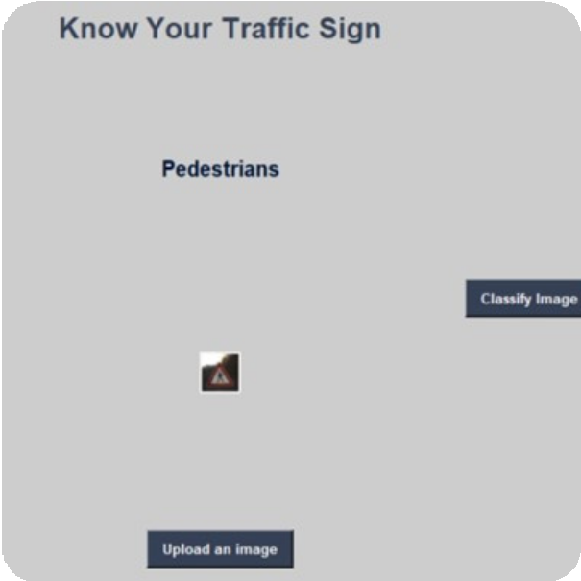
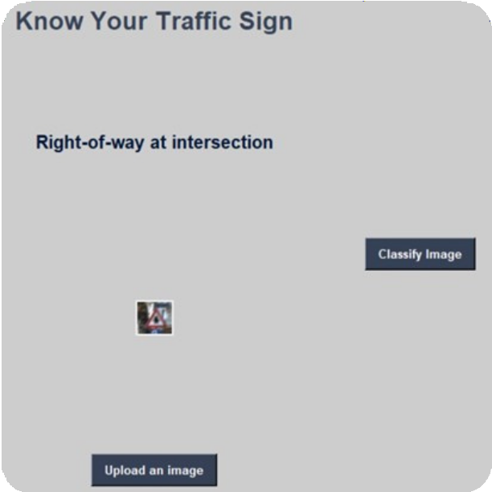
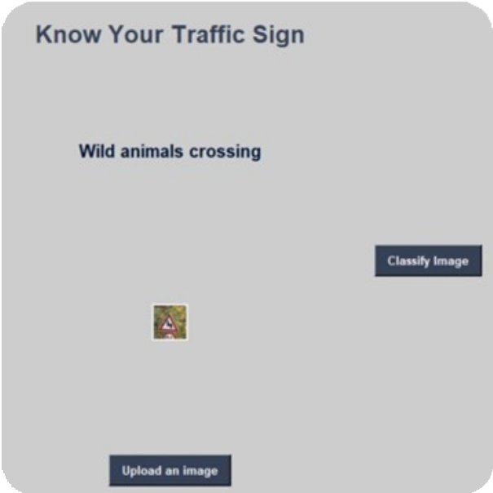
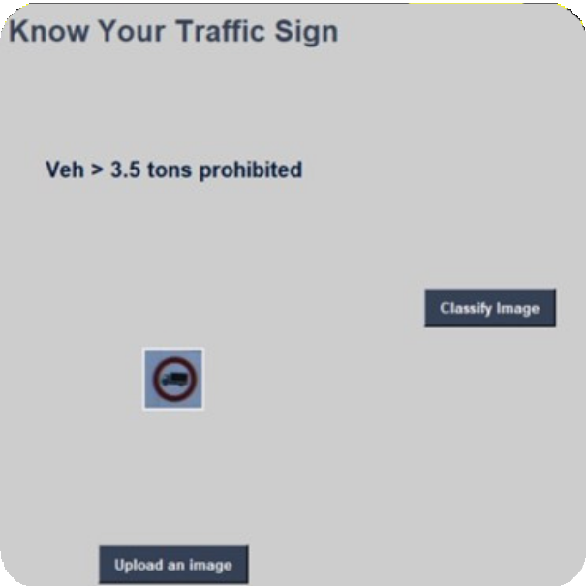



OUTPUTS

Slide 13


RESULT ANALYSIS
RESULT ANALYSIS Traffic sign classification is the process of automatically recognizing traffic signs (like speed limit, yield, and caution signs, etc.) and accordingly classifies them as to which class they belong to. The project has two main functionalities: Prediction on the newly generated dataset and live web cam traffic sign detection.

Slide 14


OBSERVATION
The proposed system is simple and does the classification quite accurately on the GTSRB dataset as well as the newly generated one (consisting of truly existing images of all type), and finally the model can successfully capture images and predict them accurately even if the background of the image is not much clear. The proposed system uses Convolutional Neural Network (CNN) to train the model. The images are pre- processed, and histogram equalization is done to enhance the image contrast. The final accuracy on the test dataset is 93% and on the built dataset is 69%.
The web cam predictions done by the model are also accurate and take very less time. The benefits of “Traffic Sign classification and detection system” are generally focused on driver convenience. Despite the advantages of traffic sign classification, there are drawbacks. There can be times when the traffic signs are covered or not visible clearly. This can be dangerous as the driver won’t be able to keep a check on his vehicle speed and can lead to accidents, endangering other motorists or pedestrians, demanding further research.

Slide 15







TEAMMEMBER'S
AJAY SAKILI
BRANCH : Artificial Intelligence SECTION : B
REG No : RA2011047010114
STUDY : 3rd Year SEMESTER : 5
MATHI THARUN
BRANCH : Artificial Intelligence SECTION : B
REG No : RA2011047010086
STUDY : 3rd Year SEMESTER : 5
DOMA PAVAN SRINIVAS
SIDDHARTH GHOSH
BRANCH : Artificial Intelligence SECTION : B
REG No : RA2011047010089
STUDY : 3rd Year SEMESTER : 5
BRANCH : Artificial Intelligence SECTION : B
REG No : RA2011047010091
STUDY : 3rd Year SEMESTER : 5
GITHUB LINK:github.com/pavansrinivasdoma/Traffic-Signs-Recognization

Slide 16
BY KOLISETTY ABHIRAM(RA2011030010218) YANDRA SREE SANTHOSH(RA2011030010214) SRIRAMULA PRANAV(RA2011030010212)

Slide 17







THANK YOU

